Slide 1
Five in a Row
By
Justin Jiang
Eric Sullivan
Leonid Melnikov

Slide 2
Introduction
This project is a 2 player game of Five in a Row, which can be played over IP
Players take turns placing their tokens on the game board
The first player to place five of their tokens in a row wins
The rows can be vertical, horizontal, or diagonal

Slide 3
Overview
Server class extends GameLogic class implements Runnable
GameLogic class – server side game logic
Client class – handles reading from and writing to server
GameBoard class extends Jframe implements ActionListener, Runnable – GUI and clientside game logic, has an instance of Client class to communicate with server

Slide 4
Client class
Default constructor – localhost
Constructor (String) – custom IP address
Send() - writes to server
Receive() - reads from server
Close() - closes connections

Slide 5
Server class
Accepts 2 client connections
Creates a new game thread using those 2 clients
Continues listening for additional pairs of clients as long as it is running

Slide 6
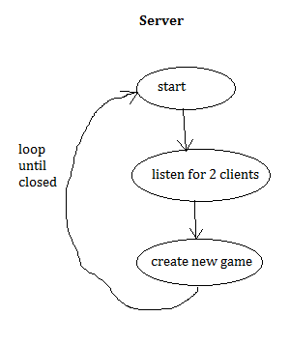

Slide 7
GameLogic class
setSockets(Socket, Socket) – sets sockets for both connected clients
Execute() - main body of game logic loop, assigns player numbers, handles player turns, determines winner, updates client gameboards
processInput(String) – uses recursion to determine if the player has made 5 in a row by checking in all directions from the last token placed

Slide 8
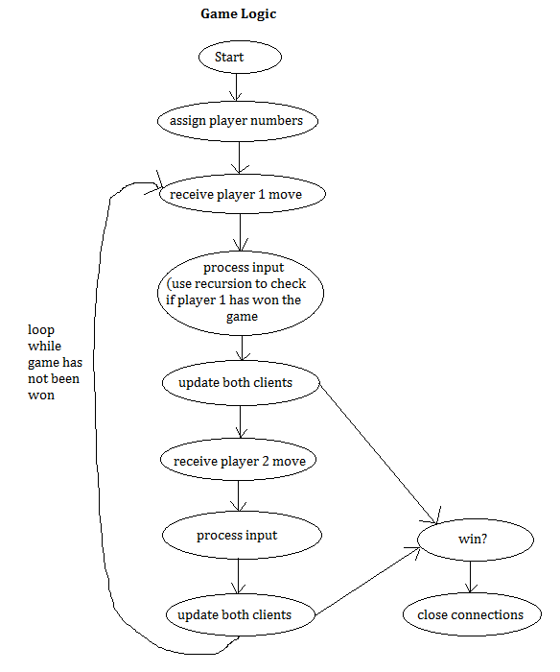

Slide 9
GameBoard class
Gameboard() - builds GUI, asks user for server IP
DrawGUI() - draws game board
Run() - game logic loop, receives from server
processInput() - processes data from server, updates game board, displays Win screen when someone wins the game.

Slide 10


